Slide 1
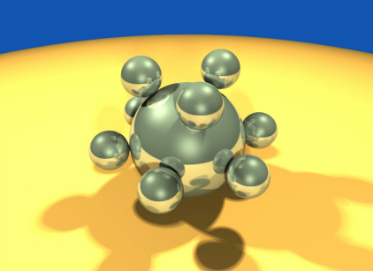
Computer Graphics using OpenGL, 3rd Edition
F. S. Hill, Jr. and S. Kelley
Chapter 1
Introduction to Computer Graphics
S. M. Lea
University of North Carolina at Greensboro
© 2007, Prentice Hall

Slide 2

What Are Computer Graphics?
Pictures generated by a computer
  Example: a ray-traced picture with shadows.

Slide 3
Computer Graphics Tools
Tools are both software and hardware.
  Hardware tools include video monitors, graphics cards, and printers that display graphics.
  They also include input devices such as a mouse, data glove, or trackball that let users point to items and draw figures.

Slide 4
Computer Graphics Tools (2)
Software tools: the operating system, editor, compiler, and debugger you commonly use.
  Graphics routines: e.g., functions to draw a simple line or circle (or characters such as G).
  Functions to manage windows with pull-down menus, input, and dialog boxes.
  Functions to allow the programmer to set up a camera in 3D coordinate system and take snapshots of objects.

Slide 5
Device Independent Graphics
Device independent graphics libraries that allow the programmer to use a common set of functions within an application, and to run the same application on a variety of systems and displays are available.
OpenGL is such a library, and is the tool we shall use in this book. The OpenGL way of creating graphics is used widely in both academia and industry.

Slide 6
Field of Computer Graphics
Computer graphics also often means the whole field of study that involves these tools and the pictures they produce.
The special interest group in graphics, SIGGRAPH, was formed in 1969. (The must-not-miss annual SIGGRAPH meeting now attracts 30,000 participants a year.)
  SIGGRAPH is a Special Interest Group in the ACM: the Association for Computing Machinery.

Slide 7
Why Study Computer Graphics?
Some people want a better set of tools for plotting curves and presenting the data they encounter in their other studies or work.
Some want to write computer-animated games, while others are looking for a new medium for artistic expression.
Most people want to be more productive, and to communicate ideas better, and computer graphics can be a great help.

Slide 8
Presentation Options
Frame-by-frame: A single frame can be drawn while the user waits. (very boring)
Frame-by-frame under control of the user: A sequence of frames can be drawn, as in a PowerPoint® presentation; the user presses a key to move onto the next slide, but otherwise has no way of interacting with the slides. (much less boring)

Slide 9
Presentation Options
Animation: A sequence of frames proceeds at a particular rate while the user watches with delight; (exciting, as in such animated movies as The Incredibles® and Shrek® )
Interactive Program: In an interactive graphics experience, the user controls the flow from one frame to another using an input device such as a mouse or keyboard in a manner that was unpredictable at the time the program was written. This can delight the eye. A computer game is a familiar case of an interactive graphics presentation. (delightful!)

Slide 10
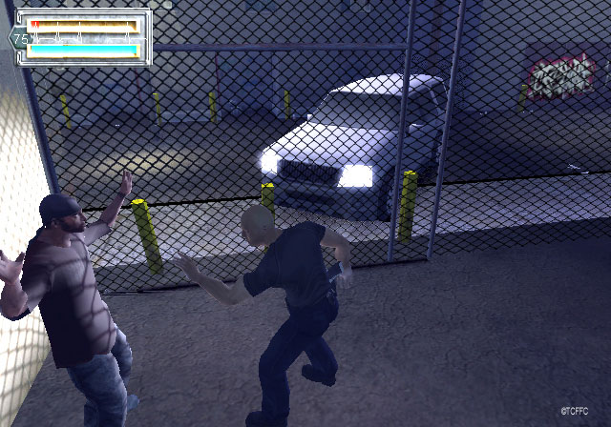
Where Are Computer Graphics Used?
Computer graphics are widely used in the production of movies, television programs, books, games, and magazines.

Slide 11
Where Are Computer Graphics Used? (2)
Browsing on the World Wide Web: the browser must rapidly interpret the data on a page and draw it on the screen as high quality text and graphics.
Slide, Book, and Magazine Design: Computer graphics are used in page layout programs to design the final look of each page of a book or magazine. The user can interactively move text and graphics around to find the most pleasing arrangement.

Slide 12
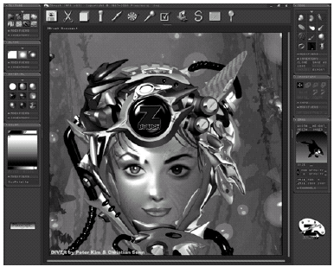
Where Are Computer Graphics Used? (3)
A paint system generates images. A common example of a paint system and photo manipulation system is Adobe Photoshop®.

Slide 13
Computer Graphics and Image Processing
Computer graphics create pictures and images based on some description, or model, in a computer.
Image processing improves or alters images that were created elsewhere.
  Processing can remove noise from an image, enhance its contrast, sharpen its edges, and fix its colors.
  Software routines can search for certain features in an image, and highlight them to make them more noticeable or understandable.

Slide 14
Process Monitoring
Highly complex systems such as air traffic control systems must be monitored by a human to watch for impending trouble.
An air traffic control system consists of monitors that display where nearby planes are situated.
  The user sees a schematic representation for the process, giving the whole picture at a glance.
  Various icons can flash or change color to alert the user to changes that need attention.

Slide 15
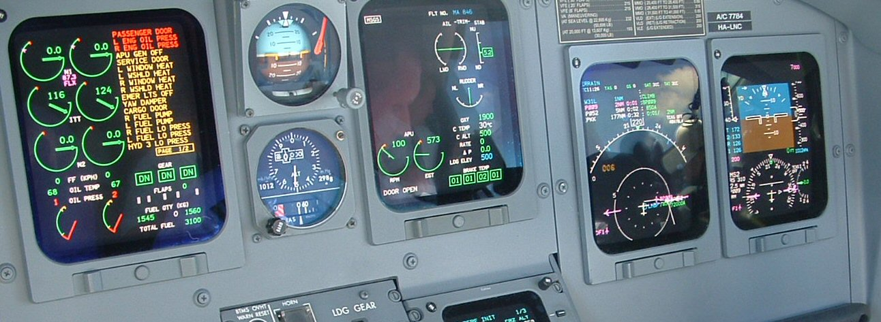
Displaying Simulations
Flight simulator: the system is a plane with a shape and flying characteristics, along with a world consisting of a landing field, mountains, other planes, and air, all modeled appropriately.

Slide 16
Computer-aided Design
E.g., drills, or houses. The computer version is easy to alter if necessary.
  Analysis and simulation can be used also. The shape of the drill might look nice, but the casing might be too weak or too heavy, or might be uncomfortable to grip.
  Algorithms can be applied to the model of the drill to analyze its weight and heft, and to test whether the inner workings of the drill will fit properly inside the casing.

Slide 17
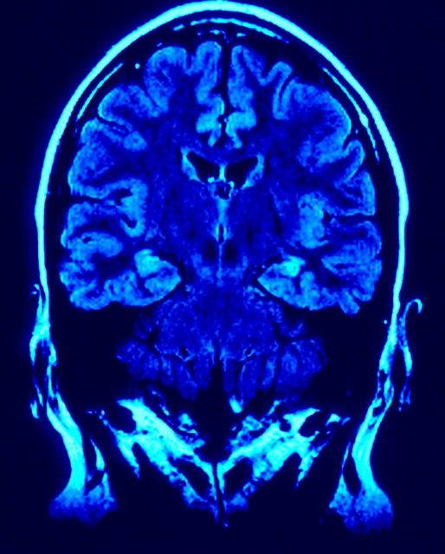
Volume Visualization
Areas of different colors immediately inform a physician about the health of each part of the brain.

Slide 18
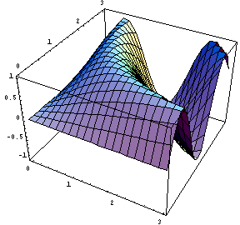
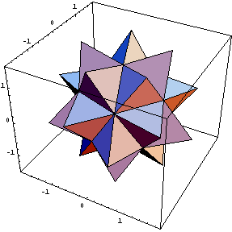
Displaying Mathematical Functions
E.g., Mathematica®

Slide 19
Elements of Pictures
Output primitives: points, lines, polylines, text, filled regions and raster images
Attributes: how an output primitive appears; e.g., color and thickness.

Slide 20
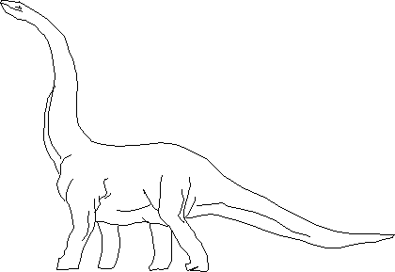
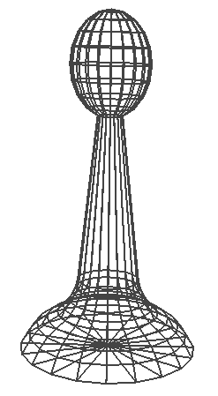
Polylines
A polyline is a connected sequence of straight lines.

Slide 21
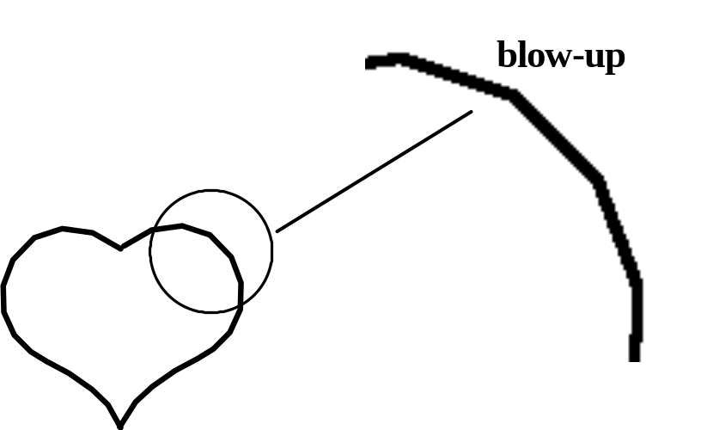
Polylines (2)
A polyline can appear to the eye as a smooth curve. This figure shows a magnification of a curve revealing its underlying short line segments.

Slide 22
Polylines (3)
Simplest polyline: a single straight line segment.
  A line segment is specified by its two endpoints, say (x₁, y₁) and (x₂, y₂). A drawing routine for a line might look like drawLine(x1, y1, x2, y2);
Dot: drawDot(x1, y1);

Slide 23
Polylines (4)
When there are several lines in a polyline, each one is called an edge, and two adjacent lines meet at a vertex.
The edges of a polyline can cross one another. A polyline does not have to be closed.
Polylines are specified as a list of vertices, each given by a coordinate pair: (x₀, y₀), (x₁, y₁), (x₂, y₂), ...., (x_{n}, y_{n}).

Slide 24
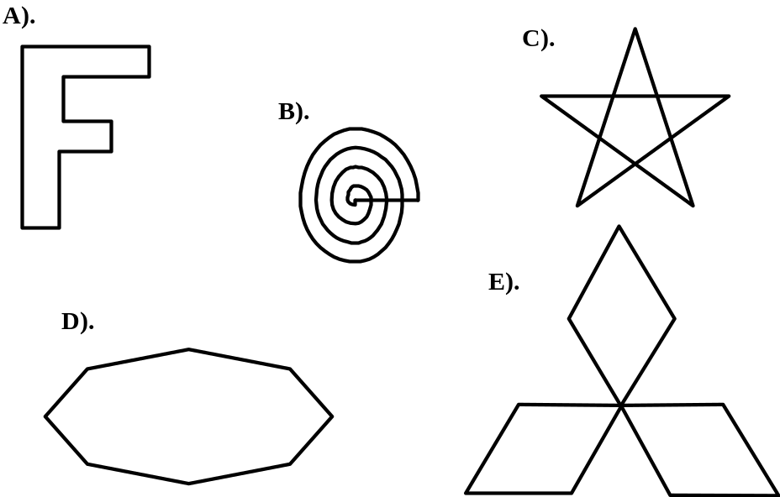
Polylines (5)
A polygon has its first and last points connected by an edge.
If no two edges cross, the polygon is called simple. Only A) and D) are simple.

Slide 25

Polyline Attributes
Color, thickness and stippling of edges, and the manner in which thick edges blend together at their endpoints.
Typically all the edges of a polyline are given the same attributes.

Slide 26
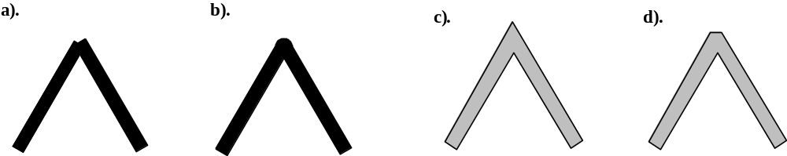
Polyline Attributes (2)
Joining ends: “butt-end”, rounded ends, mitered joint, and trimmed mitered joint.

Slide 27
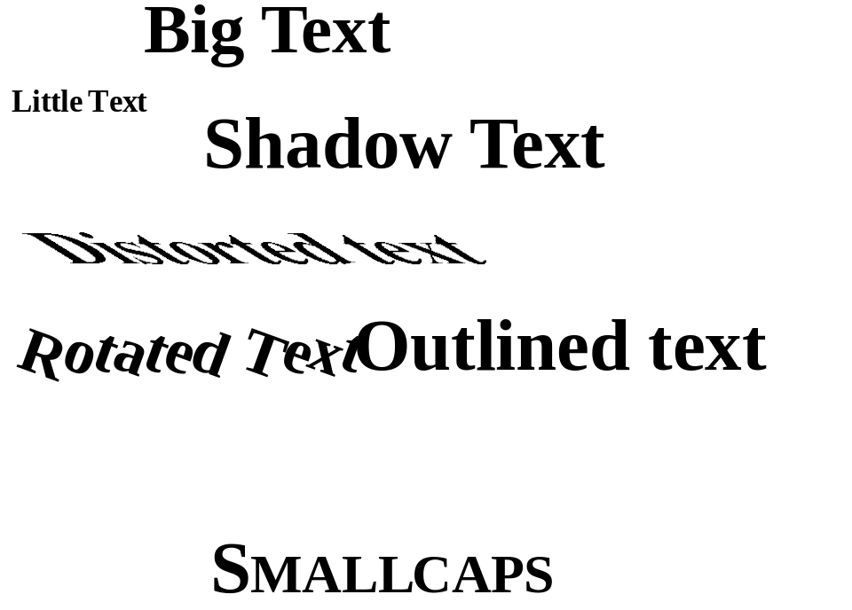
Text
Some graphics devices have both a text mode and a graphics mode.
Text in text mode uses a built-in character generator.
Text in graphics mode is drawn.

Slide 28

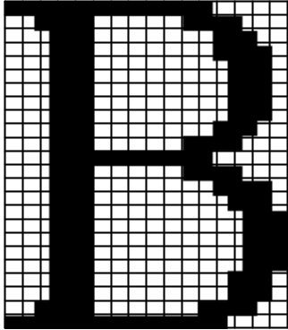
Text Attributes
Font, color, size, spacing, and orientation.
Font: Allegro or English Script
Orientation: Characters/strings may be drawn tilted (e.g., vertically).
Characters are defined by a set of polylines or by dots.

Slide 29
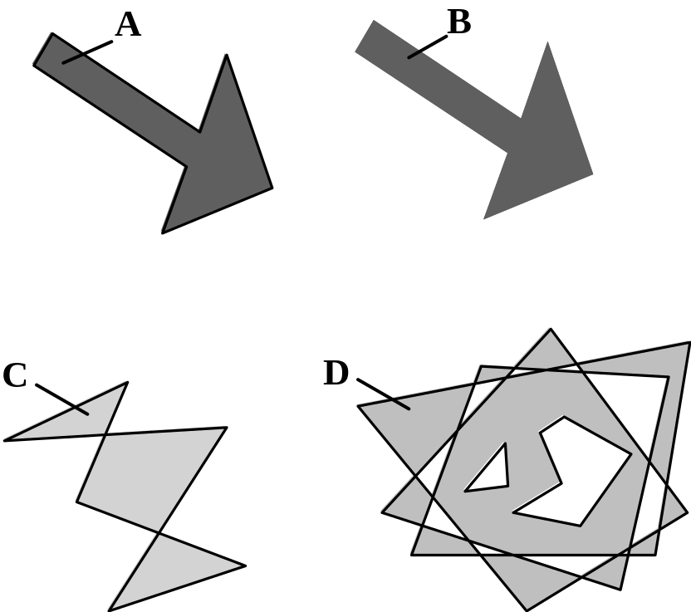
Filled Regions
The filled region (sometimes called fill area) primitive is a shape filled with some color or pattern.
Example: polygons

Slide 30
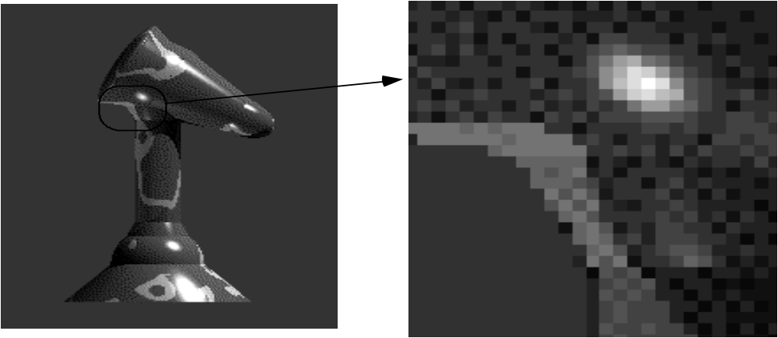
Raster Images
A raster image is made up of many small cells (pixels, for “picture elements”), in different shades of gray. (Right: magnified image showing pixels.)

Slide 31
Pixmaps and Bitmaps
A raster image is stored in a computer as a rectangular array of numerical values.
The array has a certain number of rows and a certain number of columns.
Each numerical value represents the value of the pixel stored there.
The array as a whole is often called a pixel map or bitmap.

Slide 32
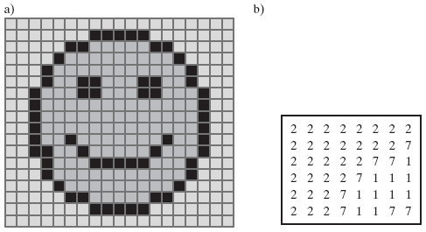
Pixmaps and Bitmaps Example
The numbers show the values in the upper left 6 rows x 8 columns of the image.

Slide 33
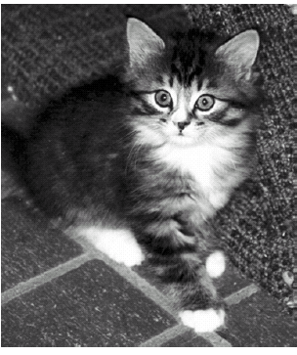
Creating Pixmaps and Bitmaps
Hand designed images, created by person.
Computed images, using an algorithm.
Scanned images.

Slide 34
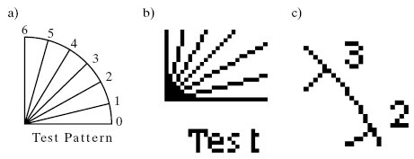
The “Jaggies”
Any close-up version of a pixmap will show that the image is composed of pixels rather than lines. Thus the lines also appear jagged (the Jaggies).

Slide 35
Color and Grayscale
Two pixel values in an image is called bi-level, or a 1 bit per pixel image. Colors are black and white.
2^{n} pixel values in an image requires n bits per pixel and gives 2^{n} shades of gray.
  Most commonly, n is 2, 4, or 8, producing 4, 16, or 256 shades of gray.

Slide 36
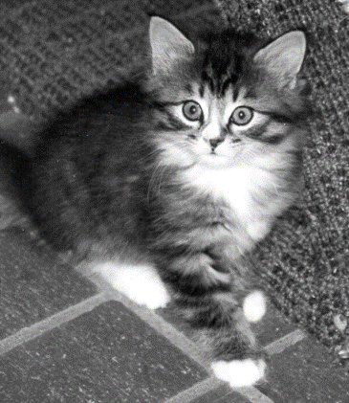
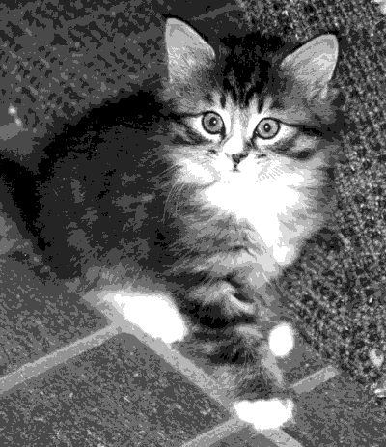
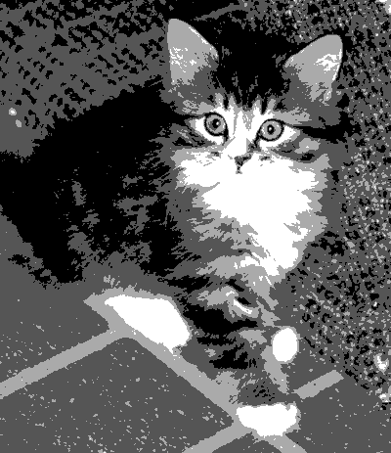
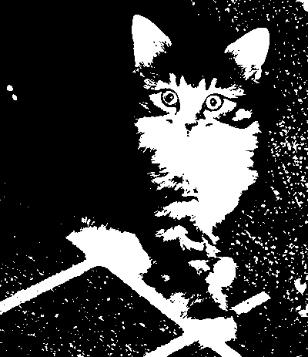
Color and Grayscale (2)
An image with 8 bits per pixel may be reduced to fewer bits per pixel by truncating values.
Gradations of gray may change to a uniform shade of gray.
Below: 6, 3, 2, and 1 bit per pixel.
.

Slide 37
Color and Grayscale (3)
Color is usually described as a combination of red, green, and blue light.
Each pixel is a 3-tuple: e.g., (23, 14, 51), for red (R), green (G), and blue (B).
The total number of bits allowed for R, G, and B values is the color depth.
  A color depth of 8 is often used: 3 bits each for R and G. and 2 bits for B.

Slide 38
Color and Grayscale (4)
  Commonly the 8-bit depth is used as an index into a table of colors (a “color look-up table, or color LUT”.)
True color images have a color depth of 24 or 32 bits.
  The color representation is excellent, but such images require huge amounts of memory to store.

Slide 39
Graphics Display Devices
Graphics displays are either line-drawing devices or raster displays.
Line-drawing devices:
  Pen plotter, which moves an ink pen across a (large) sheet of paper. (E.g., seismic wave plotters.)
  Vector video device, which moves a beam of electrons across the screen from any one point to any other point, leaving a glowing trail.

Slide 40
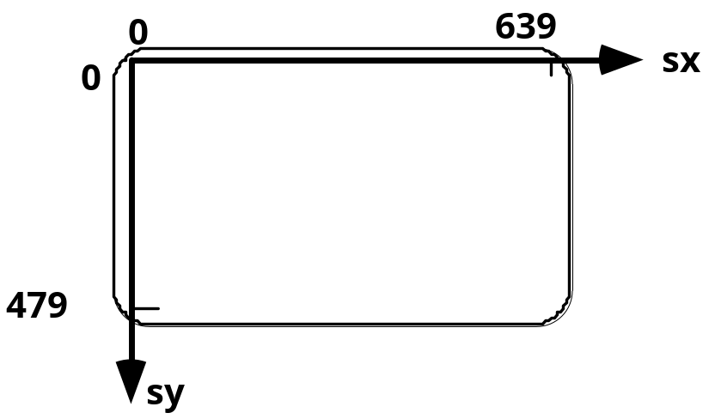
Graphics Display Devices (2)
Raster displays:
  Computer monitor: moves a beam of electrons across the screen from left to right and top to bottom.
  Printer: does the same thing with ink or toner.
  Coordinate system used:

Slide 41
Graphics Display Devices (3)
Raster displays are always connected to a frame buffer, a region of memory sufficiently large to hold all the pixel values for the display.
  The frame buffer may be physical memory on-board the display or in the host computer.
  Alternatively, a graphics card installed in a personal computer might house the frame buffer.

Slide 42
Graphics Display Devices (4)
Each instruction of the graphics program (stored in system memory) is executed by the central processing unit (CPU), storing an appropriate value for each pixel into the frame buffer.
A scan controller (not under program control) causes the frame buffer to send each pixel through a converter to the appropriate physical location on the display surface.
The converter takes a pixel value such as 01001011 and converts it to the corresponding color value quantity that produces a spot of color on the display.

Slide 43
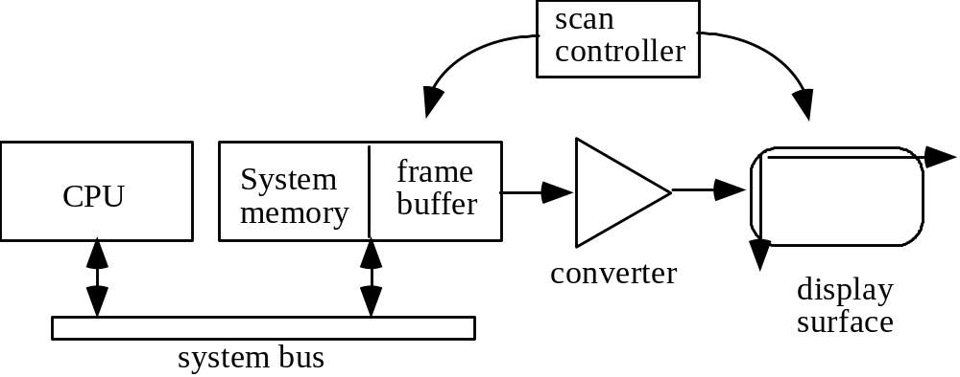
Function of Scan Controller

Slide 44
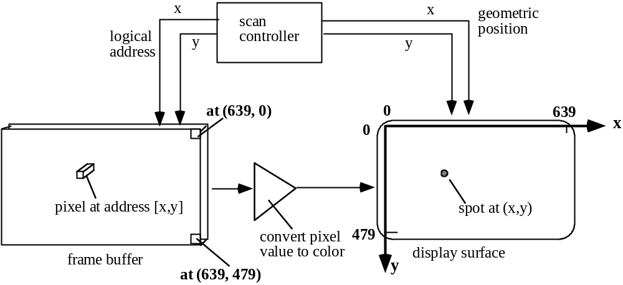
Graphics Display Device Operation

Slide 45
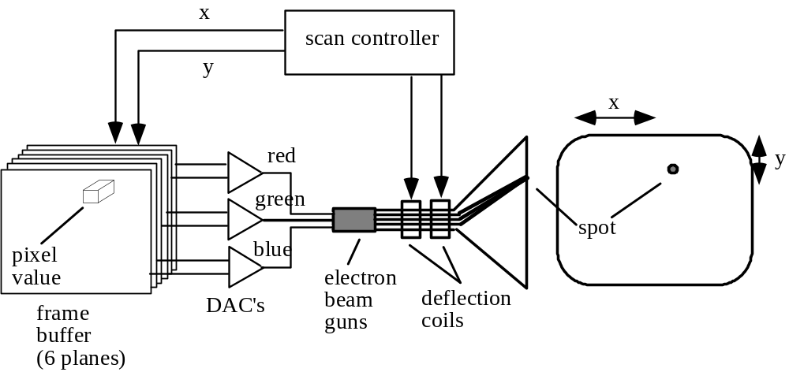
Video Monitor Operation
Based on cathode ray tube (CRT).

Slide 46
Video Monitor Operation (2)
The digital frame buffer value is converted to an analog voltage for each of R, G, and B by the DAC. Electron guns for each color are deflected to the appropriate screen location.
The process is repeated 60 times each second to prevent flicker.

Slide 47
Data Transfer Accelerators
Using 24- or 32-bit color requires that large amounts of data be transferred very fast between computer and display.
Fast buses and graphics cards can improve the transfer speed.
The cards implement the graphics pipeline: the nature of the processing steps to display the image and the order in which they must occur (specified by the graphics language, e.g., OpenGL).

Slide 48
Flat Panel Displays
The term flat-panel display refers to a class of video devices that have reduced volume, weight, and power requirements compared to a CRT
We can separate flat-panel displays into two categories: emissive displays and non emissive displays.
The emissive displays (or emitters) are devices that
convert electrical energy into light. Plasma panels, thin-film electroluminescent displays, and Light-emitting diodes are examples of emissive displays

Slide 49
Flat Panel Displays
Nonemmissive displays (or nonemitters)
use optical effects to convert sunlight or light from some other source into graphics
patterns. The most important example of a nonemisswe flat-panel display is a liquid-crystal device.

Slide 50
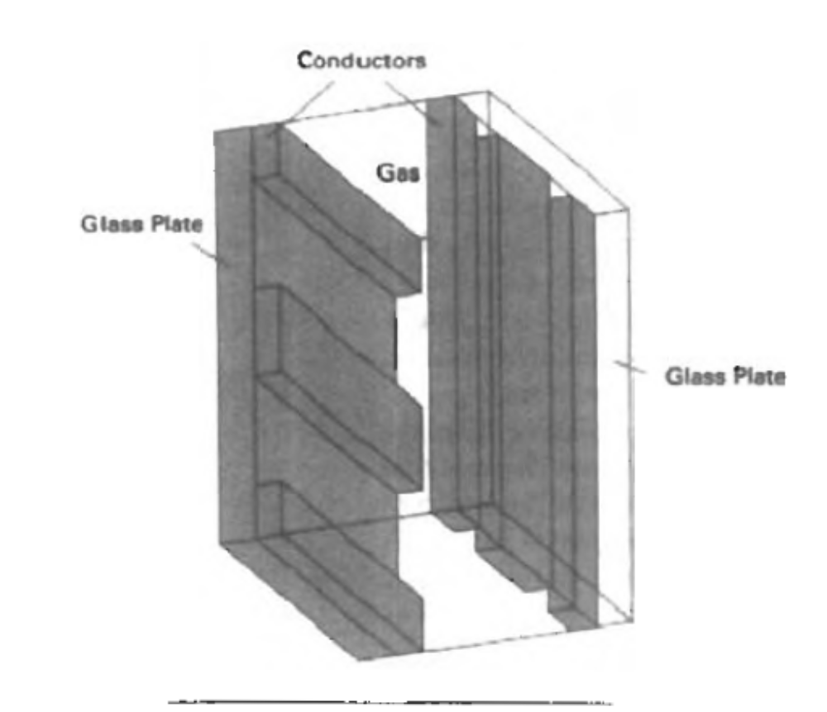
Plasma Panel Displays

Slide 51
Plasma Display
Plasma panels, also called gas-discharge displays, are constructed by filling the region between two glass plates with a mixture of gases that usually in dudes neon. A series of vertical conducting ribbons is placed on one glass panel, and a set of horizontal ribbons is built into the other glass panel.
Firing voltages applied to a pair of horizontal and vertical conductors cause the gas at the intersection of the two conductors to break down into a glowing plasma of electrons and ions.

Slide 52
Thin-film electroluminescent displays
Thin-film electroluminescent displays are similar in construction to a plasma panel. The difference is that the region between the glass plates is filled with a phosphor, such as zinc sulfide doped with manganese, instead of a gas. When a sufficiently high voltage is applied to a pair of crossing electrodes, the phosphor becomes a conductor in the area of the intersection of the two electrodes. Electrical energy is then absorbed by the manganese atoms, which then release the energy as a spot of light similar to the glowing plasma effect in a plasma panel.

Slide 53
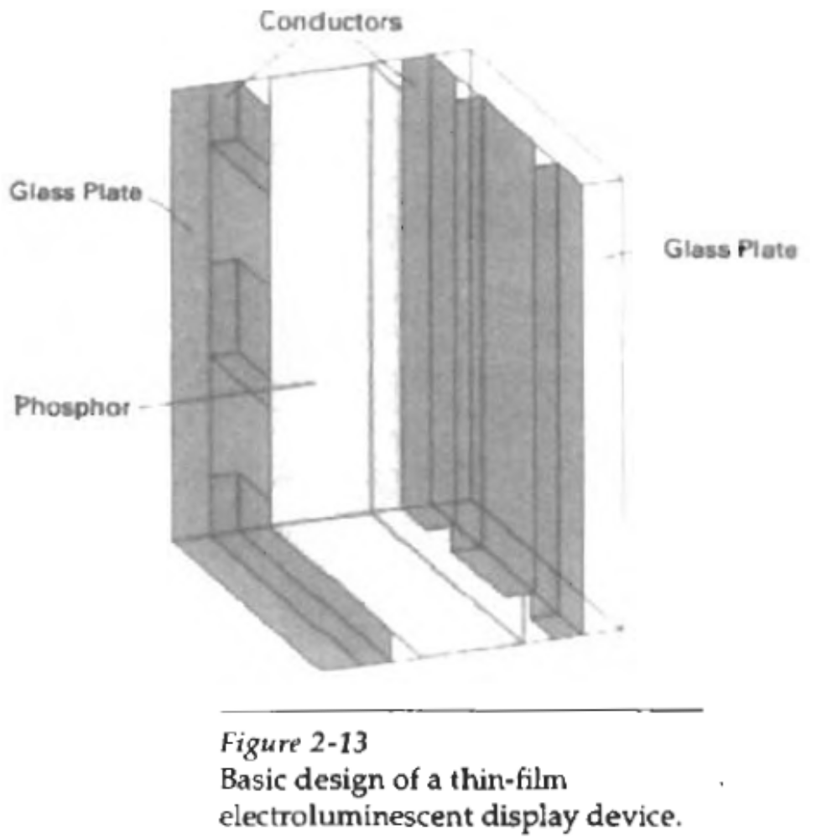

Slide 54
Liquid Cristal Displays (LCD)
LCDS are commonly used in small systems, such - as calculators) and portable, laptop computers. These none emissive devices produce a picture by passing polarized light from the surroundings or from an internal light source through a liquid- crystal material that can be aligned to either block or transmit the light. The term liquid crystal refers to the fact that these compounds have a crystalline arrangement of molecules, yet they flow like a liquid.

Slide 55
Hard Copy Raster Devices
In graphics, to reproduce a scene with colors we want a color laser or inkjet printer.
Printers equipped to use PostScript (a page description language) can generate high quality text and graphics on a printed page.
A film recorder uses a strip of photographic film, exposed by the electron beam as it sweeps over it (once) in a raster pattern. Film recorders are frequently used to make high-quality 35-mm slides, or movies.

Slide 56
Graphics Input Types
String: a string of characters followed by a termination character typed in by the user and stored in memory.
Valuator: a real value between 0.0 and 1.0, which can be used to fix the length of a line, the speed of an action, or perhaps the size of a picture.

Slide 57
Graphics Input Types (2)
Locator: a coordinate pair (x, y) which enables the user to point to a position on the display.
Pick: identifies a portion of a picture for further processing (e.g., touchscreen).
  Some graphics packages allow a picture to be defined in terms of segments, which are groups of related graphics primitives.

Slide 58
Graphics Input Devices
Keyboard: strings of characters;
  Some keyboards have cursor keys or function keys, which can be used to produce pick input primitives.
Buttons. Sometimes a separate bank of buttons is installed on a workstation. The user presses one of the buttons to perform a pick input function.

Slide 59
Graphics Input Devices (2)
Mouse: changes in position.
  Software keeps track of the mouse's position and moves a graphics cursor — a small dot or cross — on the screen accordingly.
  The mouse is most often used to perform a locate function. There are usually buttons on the mouse that the user can press to trigger the action.

Slide 60
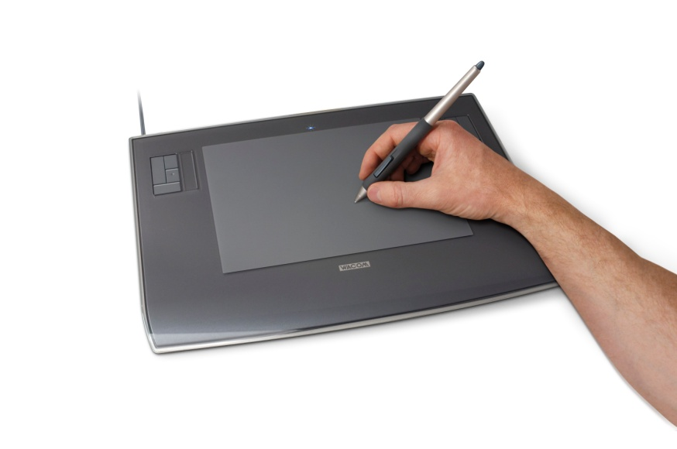
Graphics Input Devices (3)
Tablet: locate input primitives. A tablet provides an area on which the user can slide a stylus. The tip of the stylus contains a micro switch. By pressing down on the stylus the user can trigger the locate.

Slide 61
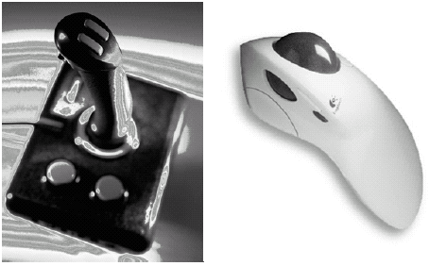
Graphics Input Devices (4)
Joystick and Trackball: locate and valuator devices.

Slide 62
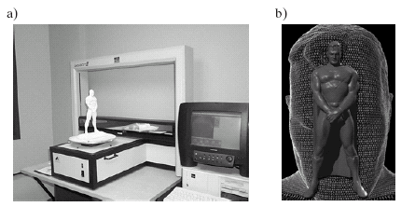
3-D Graphics Input Devices
A laser beam scans over the solid object in an x, y raster pattern, measuring the distance between the image capture device and the object.

Slide 63
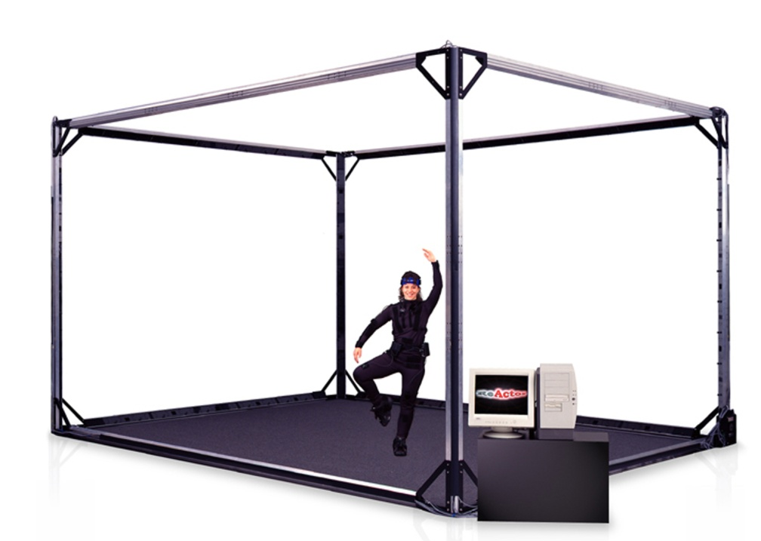
3-D Graphics Input Devices (2)
Capturing motion: a device that can track the position of many points on a moving body in real-time, saving the motion for animation or data analysis.

